Slide 1

CAPACITIVE PROXIMITY SENSOR
MLA0103-ARTIFICIAL INTILIGENCE AND EXPERTS SYSTEMS
CO4-AT3-Technical Presentation
By:
K Sathwik Kumar
192425051
Faculty:
Dr M Prakash

Slide 2
INTRODUCTION
Capacitive Proximity Sensor
A capacitive proximity sensor is a non-contact sensor used to detect the presence or absence of an object.
It works by detecting changes in the electrical capacitance around its sensing surface.
It can detect both metallic and non-metallic objects, including plastic, glass, wood, paper, liquids, and human bodies.
The sensor does not need physical contact with the object.
It is commonly used in industrial automation, object detection, level sensing, and touch-sensitive systems.

Slide 3
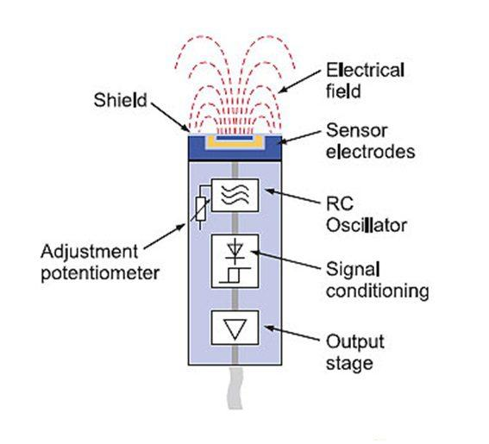
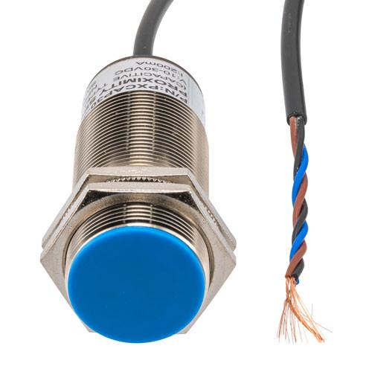
IMAGE AND COMPONENTS
Main Components:
Sensing Electrode – Creates the electric field used for detecting objects.
Oscillator – Generates the electrical signal required for sensing.
Signal Processing Circuit – Detects changes in capacitance.
Threshold/Comparator Circuit – Determines whether an object is present.
Output Circuit – Sends the detection signal to a PLC, controller, or other device.
Sensor Housing – Protects the internal electronic components.

Slide 4
HOW THE COMPONENT WORKS
Explanation
The sensing electrode continuously produces an electrical field.
When an object enters the sensing range, it changes the capacitance near the electrode.
The internal oscillator responds to this change.
The electronic circuit compares the detected signal with a predefined threshold.
If the change is large enough, the sensor switches its output ON.
When the object moves away, the capacitance returns toward its original value and the output switches OFF.

Slide 5
APPLICATIONS
Applications:
Industrial Automation – Detecting objects on conveyor belts.
Liquid Level Detection – Detecting the level of water, oil, chemicals, and other liquids inside containers.
Packaging Industries – Detecting bottles, boxes, plastic containers, and packaging materials.
Material Detection – Detecting wood, glass, plastic, paper, and metal.
Touchless Control Systems – Detecting the presence of a hand or finger.
Automotive Systems – Used for object and position detection.
Smart Manufacturing – Monitoring and controlling automated production processes.
Advantages
Non-contact + Fast + Versatile + Easy to Automate

